Slide 1
Command-line Drupal
J-P Stacey, Torchbox Ltd
Oxford Drupalcamp, 22 June 2012
Notes:
How can people maintain
.
configure
.
and even interact with
.
a Drupal site at the command line?

Slide 2

Before we start
✘
$ █
✔
Notes:
YOU: assume you don't need notes
.
notes at bit.ly link, given at end
.
ME: I assume you can use a Unix command line.
.
You might even be a sysadmin.

Slide 3
When a GUI just won't cut it
What to use when it doesn't
The basic toolkit [demo]
Deploying Drupal [demo]
I'm done!
Notes:
When a GUI just won't cut it
What to use when it doesn't
The basic toolkit [demo]
Deploying Drupal [demo]
I'm done!

Slide 4
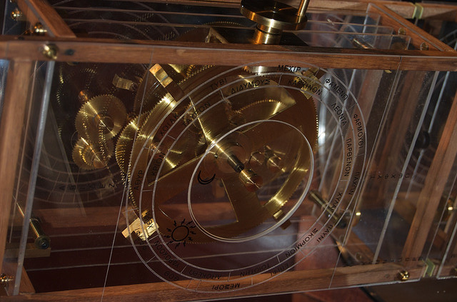

Your site needs maintaining
CC BY wikimedia:NAMA Machine d'Anticythère 1.jpg
CC BY-NC-SA flickr:tobascodagama/3106398602
Notes:
Antikythera Mechanism
Made in C1st BC, sunk off island
TWO THOUSAND YEARS of neglect
.
Modern-day, slightly steampunk reconstruction
American Computer Museum (?)
.
I like to think: this is what the mechanism might still look like, if it had been better maintained
.
To promote well-maintained sites, we need to make site interactions easy.

Slide 5
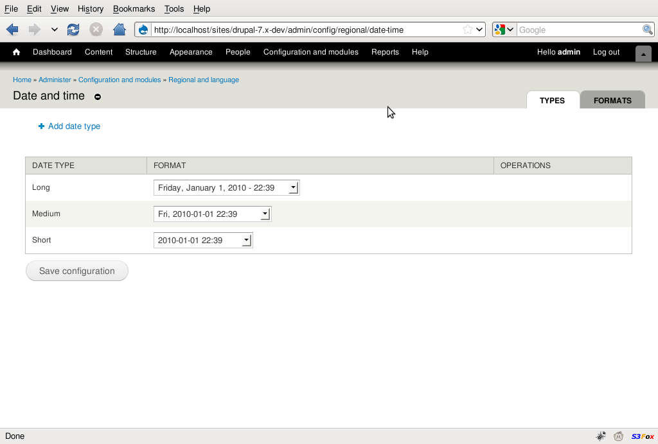
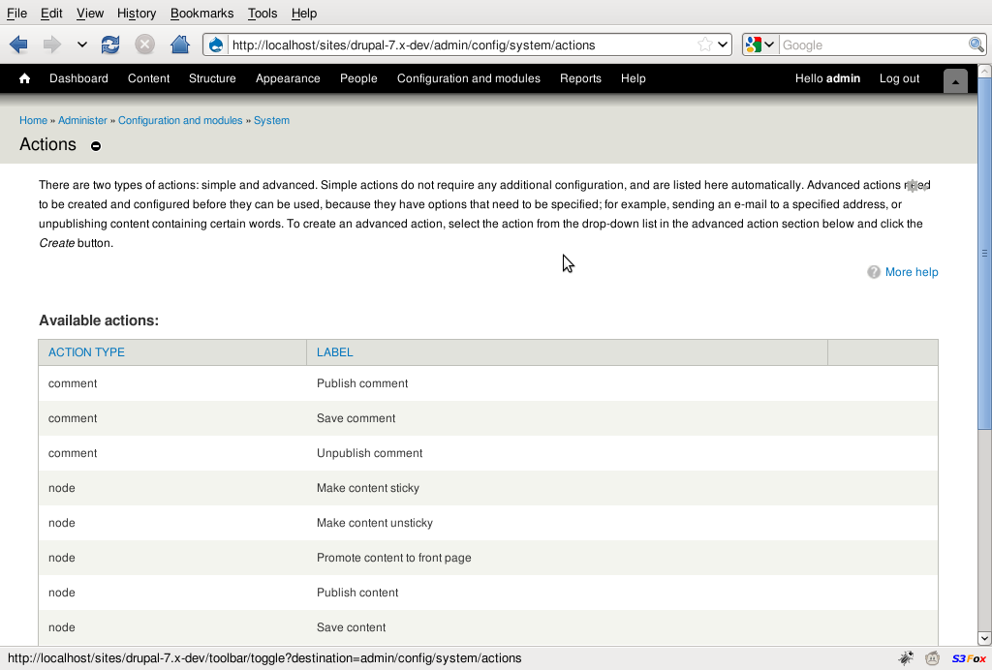
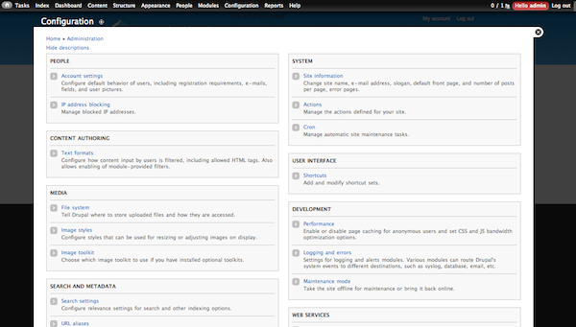
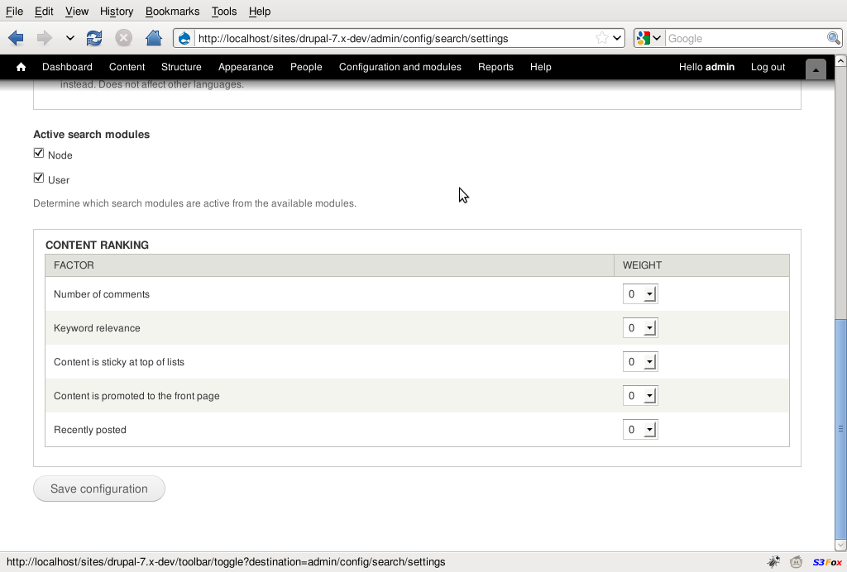
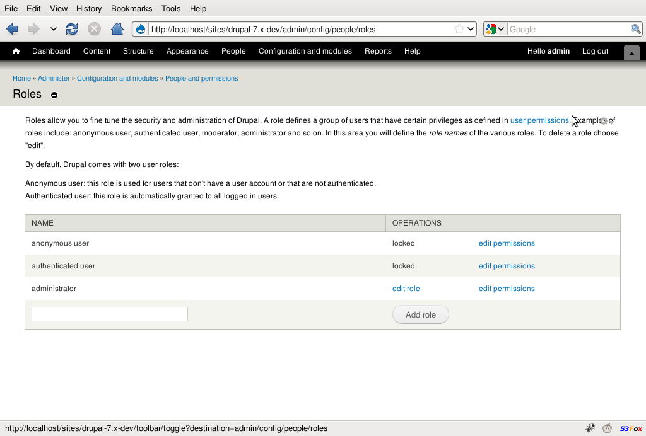
Drupal has a great GUI...
Notes:
Lot of usability research, invested time
.
does a lot of things in a fairly succinct way

Slide 6
What
if
folks
won't
CAN'T
use
the
GUI?
Notes:
[CLICK and read]
.
… What do I mean by that?

Slide 7

http://oracle-wtf.blogspot.co.uk/2012/05/girl-with-ansi-tattoo.html
won't
Notes:
Lisbeth Salander film of The Girl With The Dragon Tattoo.
.
SQL extract information from Swedish police db.
.
Good example of WON’T: works around GUI rather than submits to it.
.
(More info on link about SQL)

Slide 8
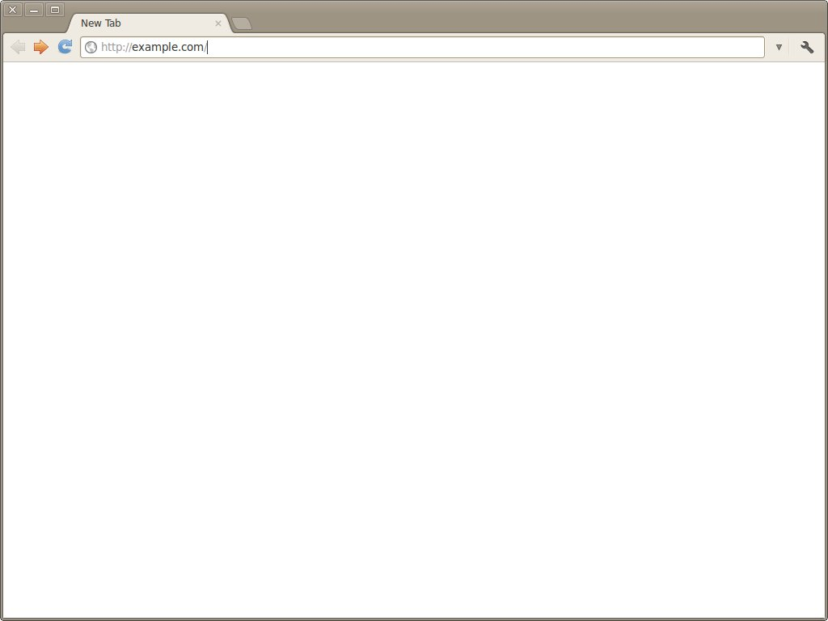
CAN'T
Notes:
More at home with the GUI?
.
what if it fails completely?
.
WSOD -> command line to fix it.
.
When you do that, going to need a CLI you can use without tearing hair out.

Slide 9
We need people who like the command line to also like Drupal
Notes:
To solve both of these problem sets...
.
We need....
.
How do we accomplish that?

Slide 10
We don't do that like this!
local $ mysqldump -u drupal_user -p \
--some-options drupal7_dc | \
gzip -c > /tmp/dc.sql.gz
local $ scp /tmp/dc.sql.gz \
remote:/tmp/dc.sql.gz
local $ ssh remote
remote$ gunzip -c < /tmp/dc.sql.gz \
| mysql -u drupal_user \
-p drupal7_dc
Notes:
Syncing a database between two machines.
.
What’s the alternative?

Slide 11


Drush
$ █
+
-
Notes:
Interface to Drupal
.
using the command line
.
without rage from trying to DIY.
.
.
Community-led project on drupal.org - comparatively active user base.

Slide 12



Installing Drush
4.x
5.x
Notes:
4.x Ubuntu (really Debian)
.
5.x for other distributions, or some of the later bits of this talk. From drupal.org
.
Largely standalone anyway
Make sure:
. on path
. not in site modules folder

Slide 13
$ drush COMMAND
[arguments]*
[--option=value]*
Notes:
drush COMMAND - without a COMMAND, drush just lists the possible commands
.
[arguments]* - most commands take at least one argument
.
[--option=value]* - command-specific and global options are available

Slide 14





Five things Drush can do
CONFIG
HEALTH
MAINTENANCE
PERFORMANCE
Notes:
This blue man is a running Drupal site. You can tell it’s running, because he’s running.
.
Health status & investigate problems
Config check config & (re)configure
Performance settings and caches
Maintenance existing modules, & users etc
[CLICK]

Slide 15
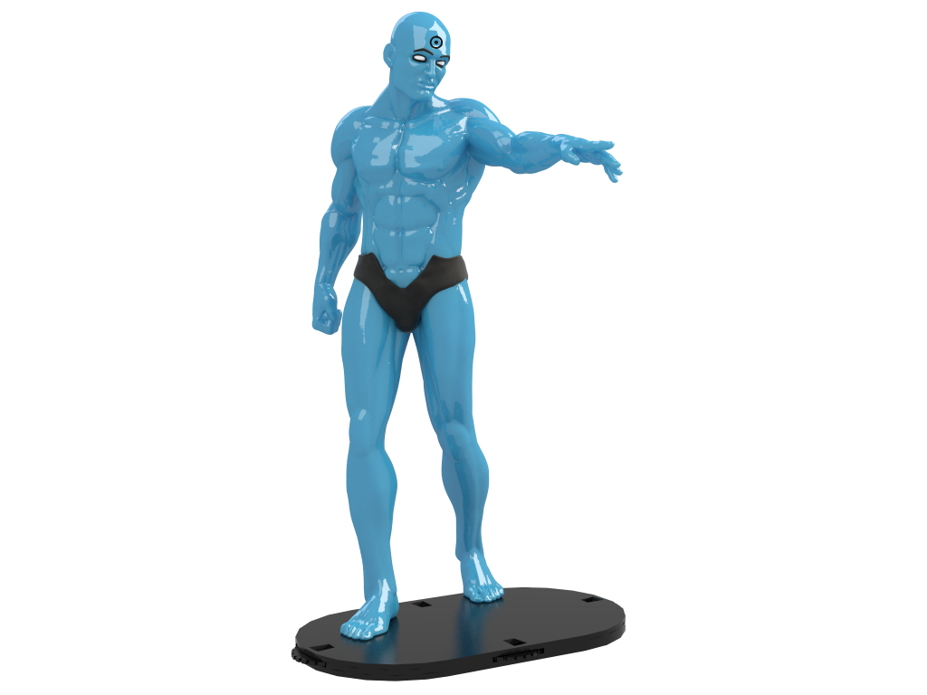
Five things Drush can do
UPGRADES
Notes:
Upgrades automate or at least semi-automate - upgrade to something more exciting, like maybe a different blue man.

Slide 16
[basics demo]

Slide 17
Going beyond
the GUI?
Notes:
Most of this stuff so far: you can do in the GUI and it's not too painful
.
Drush isn’t just intended to be a page-by-page GUI replacement.
.
Advanced drush still WIP but here I provide two solid bits of functionality.
.
We’ll then bring them together for an advanced demonstration

Slide 18
1. Alias common commands
<?php
// File: ~/.drush/drushrc.php
$options['shell-aliases'] = array(
'css-off' => 'vset -y preprocess_css 0',
'css-on' => 'vset -y preprocess_css 1',
'uptime' => '!uptime',
'apache-restart' =>
'!sudo service apache2 restart',
'mysql-restart' =>
'!sudo /etc/init.d/mysql restart',
);
5.x only
Notes:
Every time drush starts up, reads this file. PHP syntax. You can put config here - more info online, but most important for us are aliases.
.
Alias both internal Drupal commands and also (with a prefixed exclamation mark) external commands.
.
These are like bash shell aliases - basic drop-in replacements. They don’t do anything clever with your other arguments (yet).
.
Note: 5.x only

Slide 19
2. Run drush remotely
<?php
// File: ~/.drush/aliases.drushrc.php
$options['whitehouse.live'] = array(
// Local OR remote
'uri' => 'whitehouse.gov',
'root' => '/var/www/drupal6-white',
// Remote
'remote-host' => 'pasha.whitehouse.gov',
'remote-user' => 'bobama',
);
4.x 5.x
Notes:
aliases.drushrc.php - shorthands for Drupal instances
.
Local AND remote
.
Remote: a bit like remote part of e.g. Fabric or Capistrano. SSH in, run command, then exit.
.
So you’ll need drush installed on the remote servers too.
.
Typically, drush won’t prompt for a password. You can add a setting to drushrc.php to change this.

Slide 20
Making a dev copy of a Drupal website
[advanced demo]

Slide 21
“We need people who like the command line to also like Drupal”
Notes:
So, to recap: we need people who like...

Slide 22
We CAN do that like this
local $ mysqldump -u drupal_user -p \
--some-options drupal7_dc | \
gzip -c > /tmp/dc.sql.gz
local $ scp /tmp/dc.sql.gz \
remote:/tmp/dc.sql.gz
local $ ssh remote
remote$ gunzip -c < /tmp/dc.sql.gz \
| mysql -u drupal_user \
-p drupal7_dc
local $ drush sql-sync @dc.local @dc.remote
Notes:
And here’s one way we can do that
.
This was the code for syncing databases I showed earlier
.
And this is what it’s become now!
.
So I hope that I’ve shown today that

Slide 23
$ █
+
-
Notes:
If your sysadmins are introduced to Drush, then
[CLICK] You’ll get Drupal sites
[WAIT] With a bit more of this
[WAIT] And a bit less of this
[CLICK] for thankyou

Slide 24
Thank you!
bit.ly/talk-cli-drupal
(github.com/jpstacey/talk-command-line-drupal)
Torchbox: torchbox.com / @torchbox
Me: www.jpstacey.info / @jpstacey

